Slide 1
LAB SESSION
CHALLENGE OF THE WEEK
Instructor: Edwin oduor

Slide 2
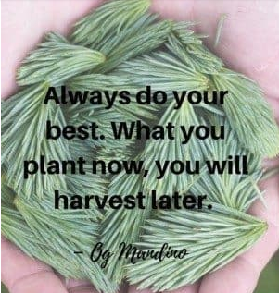
Quote of the day

Slide 3
EXERCISES

